Slide 1
Agenda part 1. . .
. . .part 2
Pillars of Municipal Innovation
Learning & Lecture
Syracuse Stories
Three Pillars with Examples
Behavioral Science
Human Centered Design
Evaluation
Q&A
Putting to Practice
Activity Introduction
Group Discussion Round 1
Behavioral Science
Human Centered Design
Evaluation
Share-out
Group Discussion Take 2 (potential to take out)
Closing

Slide 2
Activity
Pillars of Municipal Innovation
Problem 1: We need to cite more health and safety issues in homes
Explanation: Code inspectors are only citing the issues that are complained about.
Problem 2: We need to standardize what we are citing
Explanation: Each problem in a house can be cited multiple ways. For example, you could cite poor ventilation with three different NYS codes. We weren’t able to get a sense about the most common type of violation because things were cited inconsistently.

Slide 3
What are some things you could measure?
Notes:
Go over challenge

Slide 4
Select your metric

Slide 5
Favorite Ways to Measure
Reduce variance from 10% to 5%
Fill 95% of pothole complaints within 48 hours
Increase compliance from 20% to 30%
Achieve 90% satisfaction from constituents
Increase the median (or mean) calls to CityLine from 50 to 100 per day.
500 people will participate.
Notes:
Select the metric

Slide 6
Set your target

Slide 7
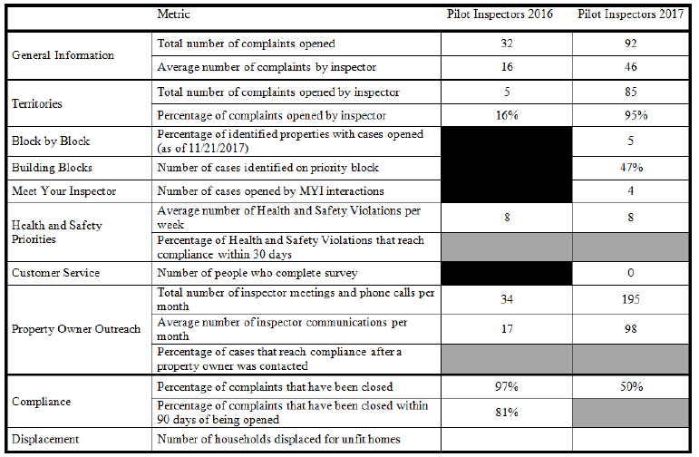
Data Visualization

Slide 8
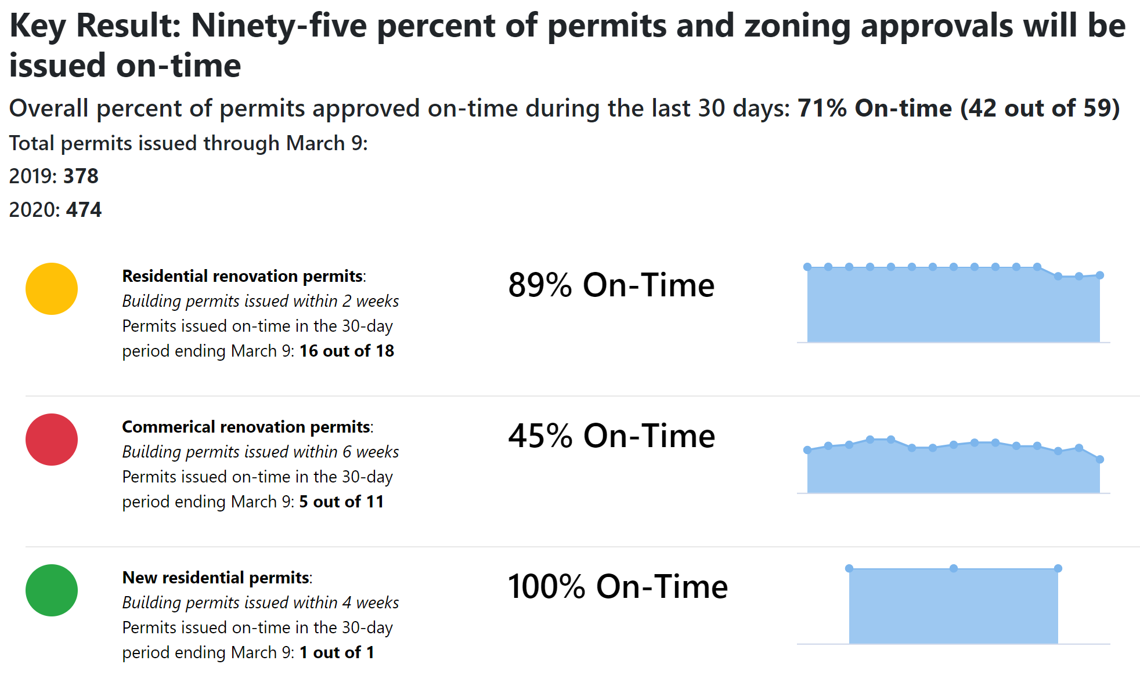
Data Visualization

Slide 9
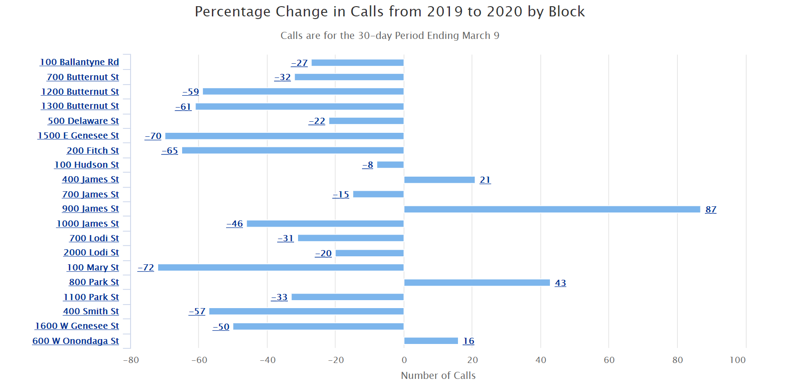
Data Visualization

Slide 10
Data Visualization
Pending
Doing
To Do
HOME!
Notes:
Neat example that Adria really loves. You can make them look like anything and tie just about anything that could be motivating to your team.

Slide 11
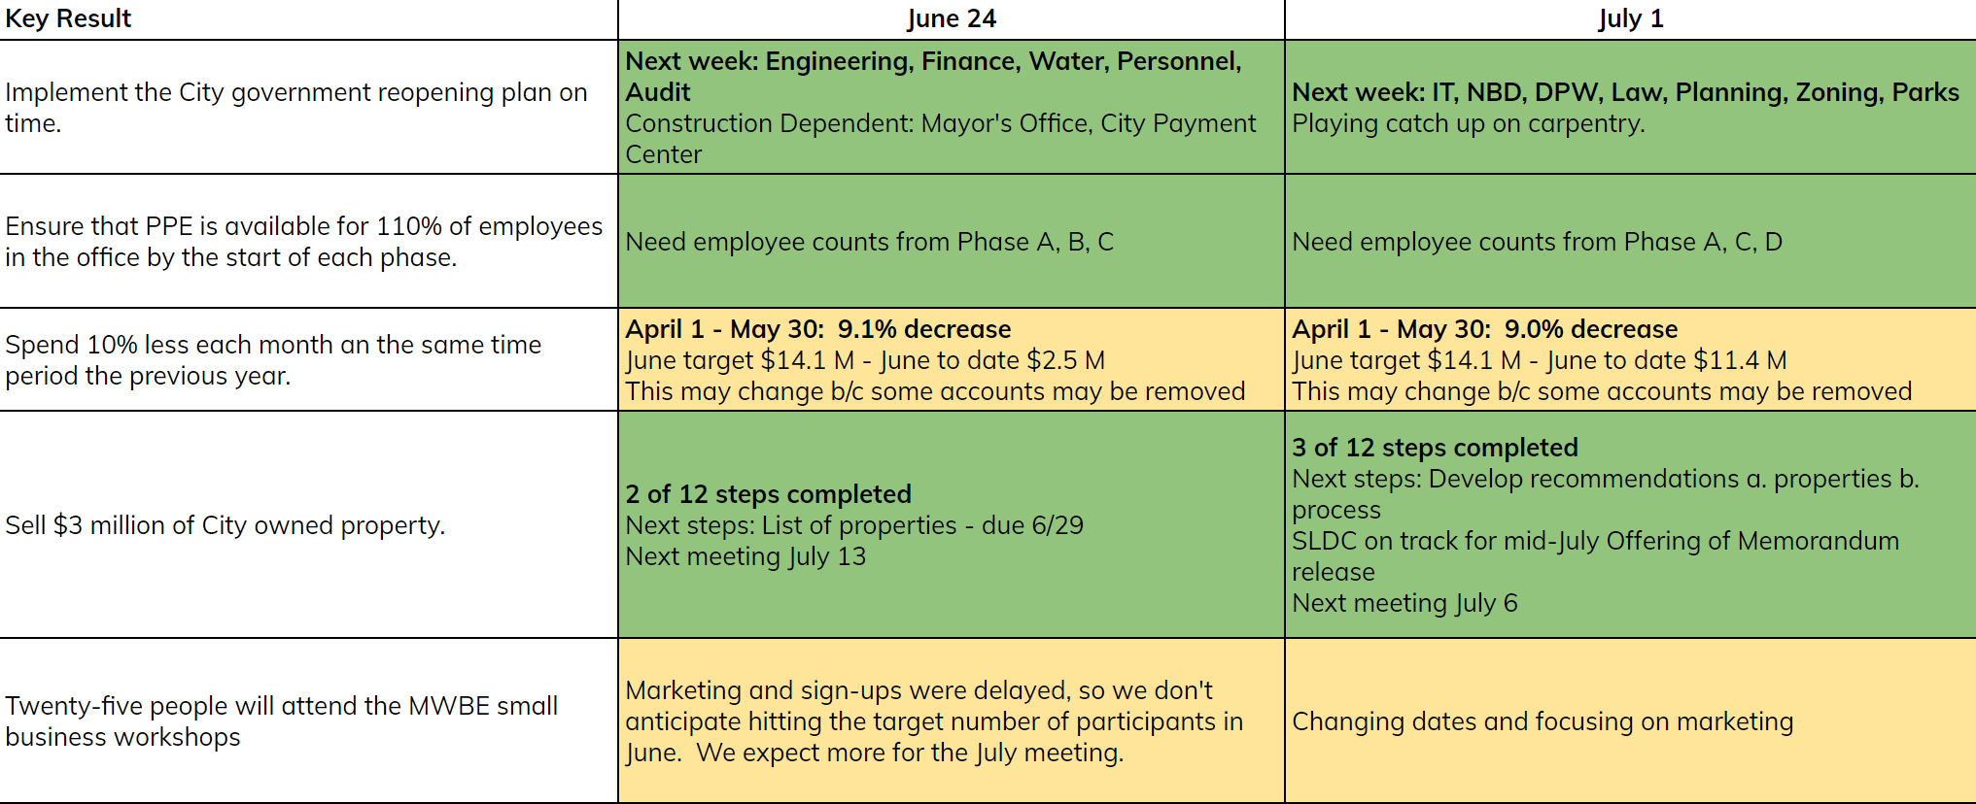
Data Visualization

Slide 12
Prototype Time!

Slide 13
Data Review
How often will the data be updated?
Who will review?
How frequently will each person review?
How are the reviews structured?
Individually or a group?
Everyone gets data ahead of time - or - look at it at the same time?
Who presents the data?
Does the data get shared with people external to the project?
Who?
When?

Slide 14
Develop Review Plan

